Slide 1
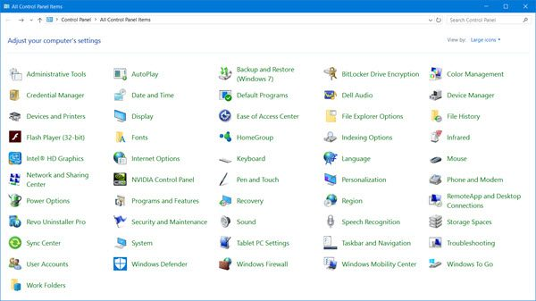
Term 1 Project Control Panel
Created by Collin Gorman

Slide 2
Table of contents part 1
Slide 1: Title Slide 15: Fonts
Slide 2/3: Table of contents Slide 16: HomeGroup
Slide 4: Mouse Slide 17: Work Folders
Slide 5: File History Slide 18: Sync Center
Slide 6: Recovery Slide 19: Internet options
Slide 7: Region Slide 20: Indexing options
Slide 8: Sound Slide 21: Windows to go
Slide 9: Keyboard Slide 22: Storage Spaces
Slide 10: Date and time Slide 23: Administrative Tools
Slide 11: Language Slide 24: Troubleshooting
Slide 12: Infrared Slide 25: Programs and Features
Slide 13: AutoPlay Slide 26: Flash Player
Slide 14: Speech Recognition Slide 27: Ease of Access Center

Slide 3
Table of contents part 2
Slide 28: Mail Slide 39: User Accounts
Slide 29: Taskbar and Navigation Slide 40: Color Management
Slide 30: Intel Graphics and Media Slide 41: BitLocker
Slide 31: Credential manager Slide 42: Default Programs
Slide 32: Phone and Modem Slide 43: Security and Maintenance
Slide 33: Network and Sharing Center Slide 44: System
Slide 34: Quicktime
Slide 35: Backup and Restore
Slide 36: RemoteApp
Slide 37: File Explorer Options
Slide 38: Audio Manager

Slide 4
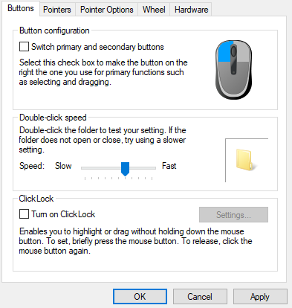
Mouse
Mouse allows you to determine the speed of double-clicks, swap the primary/secondary clicks, change the speed of the pointer, etc.

Slide 5
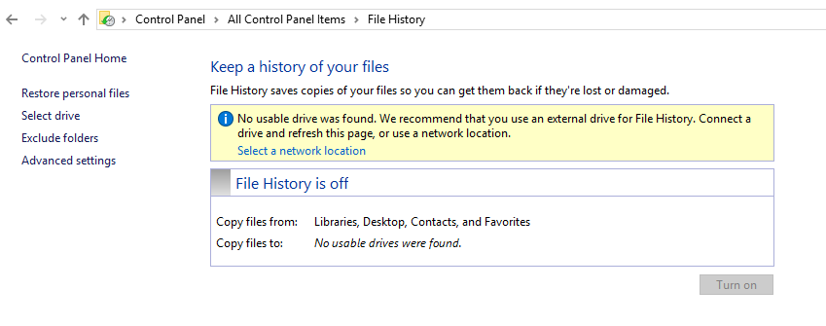
File History
File History creates copies of files so you are capable of getting them back if they were damaged or lost
These files can be given from specific drives

Slide 6
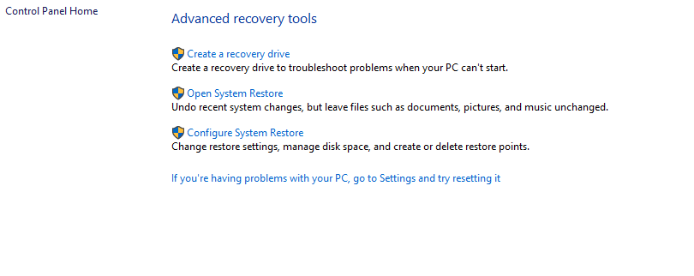
Recovery
Recovery allows you to create a recovery drive for troubleshooting purposes whenever your PC won't start
This also allows you to manage disk space and change restore settings

Slide 7
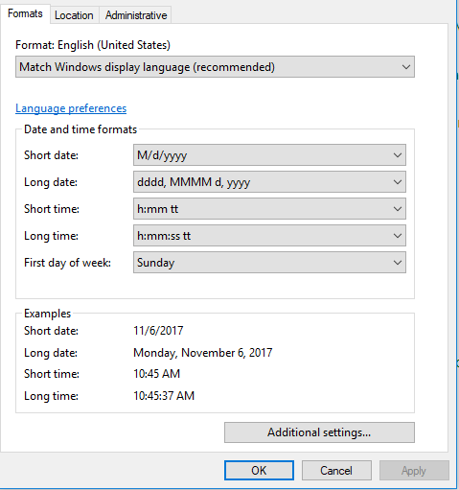
Region
Region lets you determine your PC's location, time, and date.

Slide 8
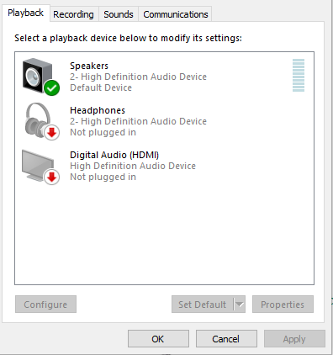
Sound
Sound lets you select what playback device your using (such as speakers or headphones), your recording device (like a microphone or something similar), etc.

Slide 9
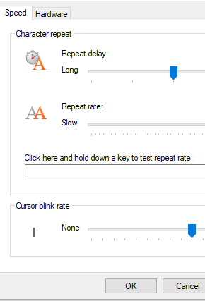
Keyboard
Keyboard can change the cursor blink rate, determine what specific keyboard you're using, and change the repeat rate and delay.

Slide 10
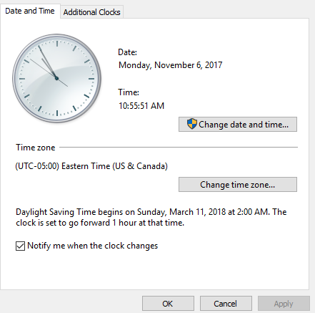
Date and time
Date and time lets you change your time zone and change your general date and time

Slide 11
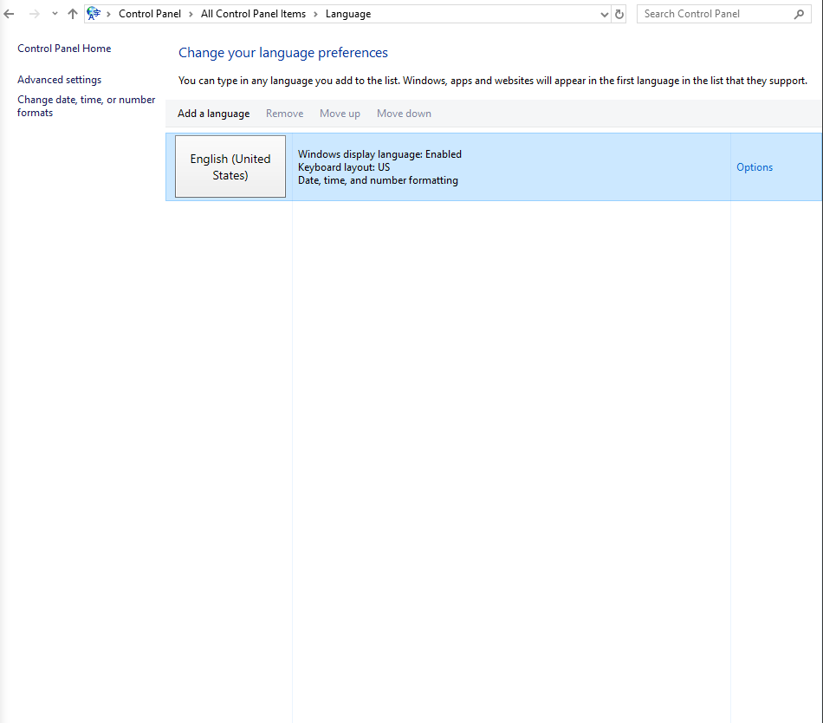
Language
Language, fairly obviously, allows you to change your system's language. It's typically automatically set to English.

Slide 12
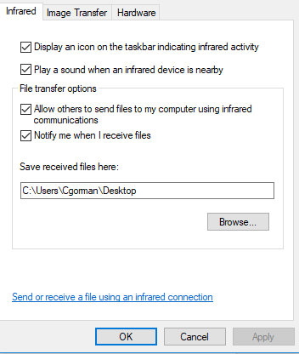
Infrared
Infrared lets you send files through images. This section allows you to change minor settings like notify when Infared signals are detected.

Slide 13
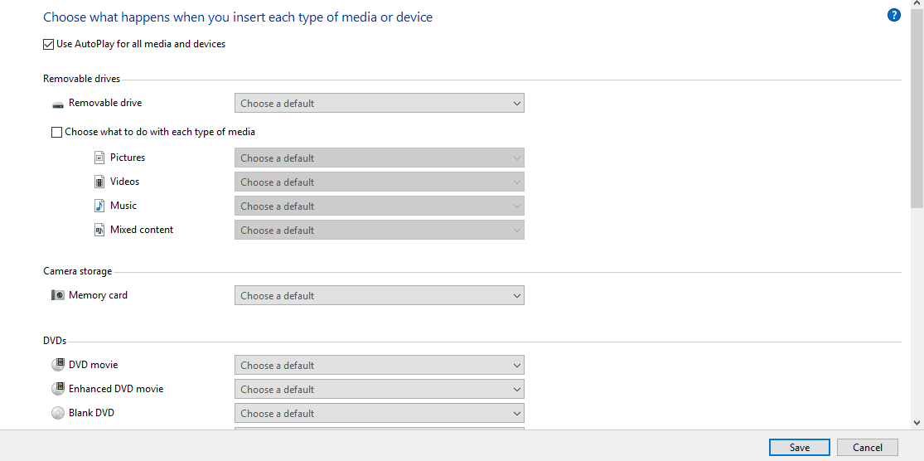
Autoplay
Autoplay examines when a mobile device or something similar is plugged into the computer. It opens a window that lets you do specific features with the mobile device, such as play music or examine the files.

Slide 14
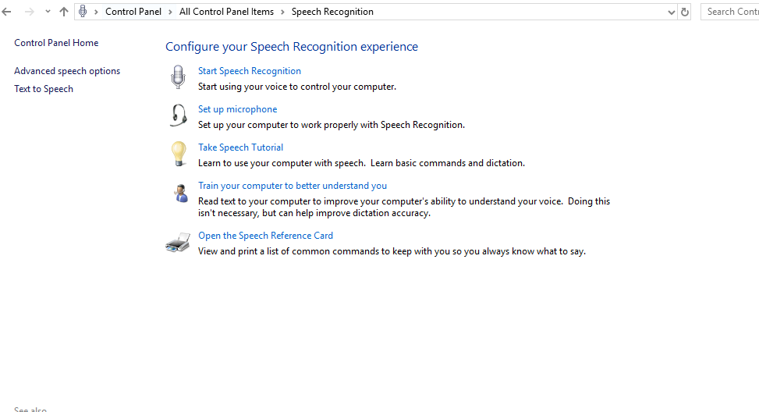
Speech recognition
Speech Recognition allows you to make Windows recognize your voice and use to do commands with it. You can also set up what specific microphone you want associated with this program.

Slide 15
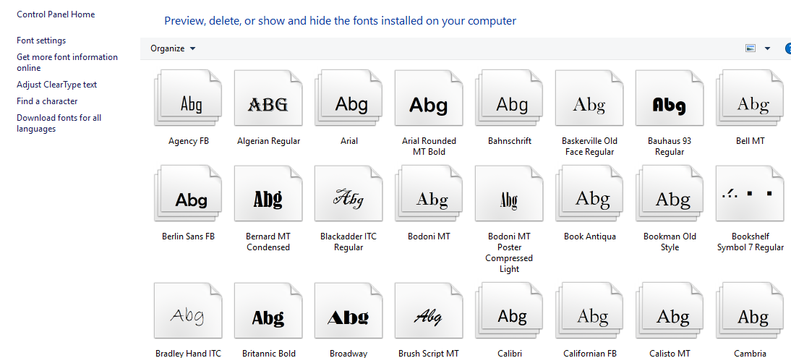
Fonts
Fonts allows you to view what fonts are saves on your computer and lets you delete them if you choose.

Slide 16
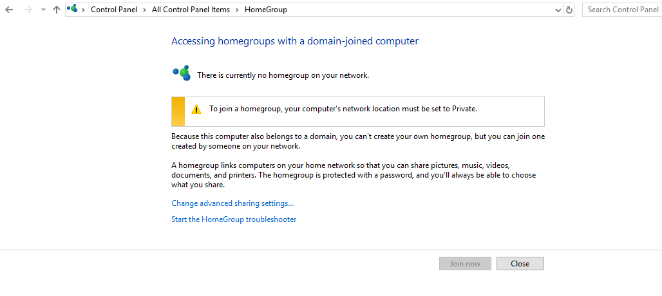
Homegroup
A homegroup is a series of PCs on a home network letting you share printers, files, etc. The section in Control Panel allows you to join any homegroups near you.

Slide 17
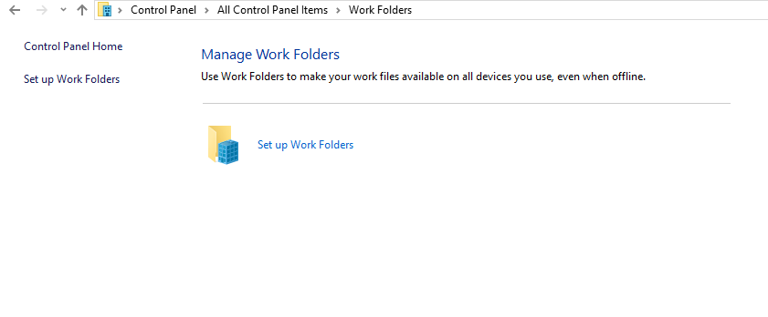
Work Folders
Work Folders allow your files to be accessible on all devices even when online.

Slide 18
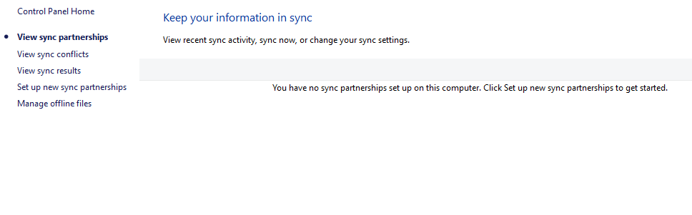
Sync Center
Sync Center allows you to sync your computer activity and view that activity. You can also manage offline files or view any conflicts that go with your syncs.

Slide 19
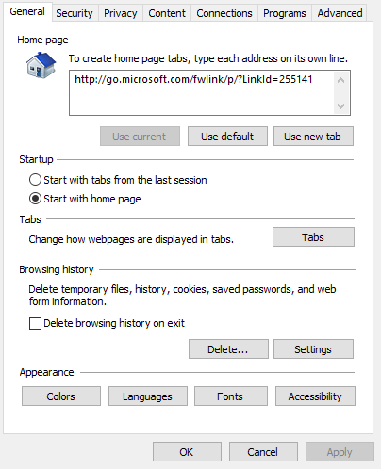
Internet Options
Internet Options lets you determine the security of what location you're in, use adblocker, or set an option delete your browser history on exit.

Slide 20
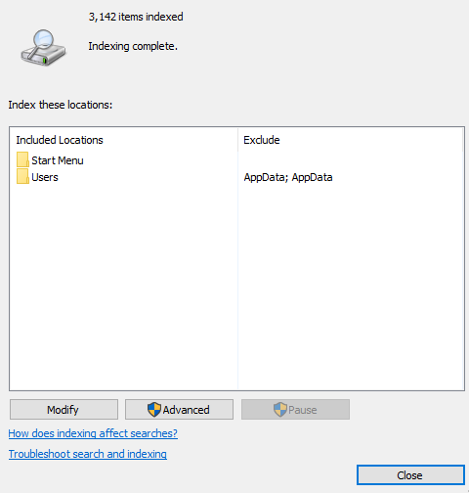
Indexing options
Indexing options lets you view what locations your items have been indexed.

Slide 21
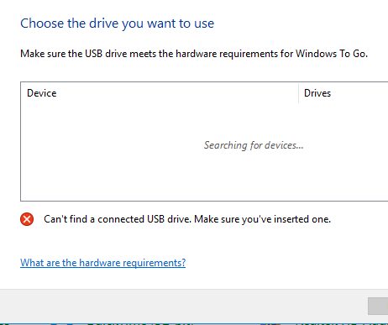
Windows to go
Windows to go allows you to transfer a copy of windows to a USB or disk.

Slide 22
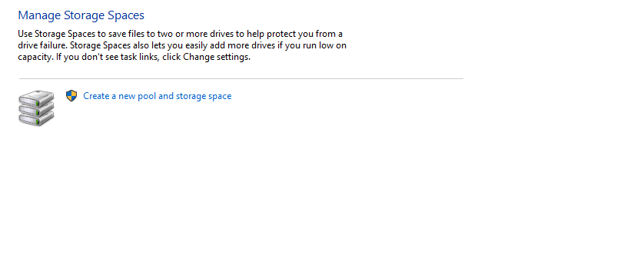
Storage Spaces
This lets you save files to multiple drives if one drive fails.
You can also add more drives if one lows run on capacity

Slide 23
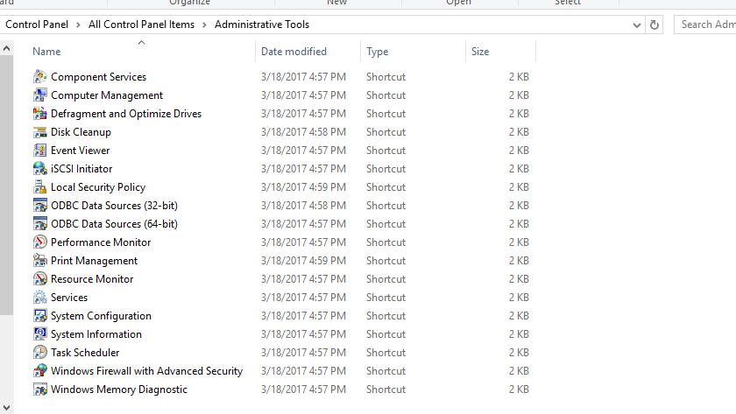
Administrative Tools
This gives you access to a large variety of applications mainly for administrators

Slide 24
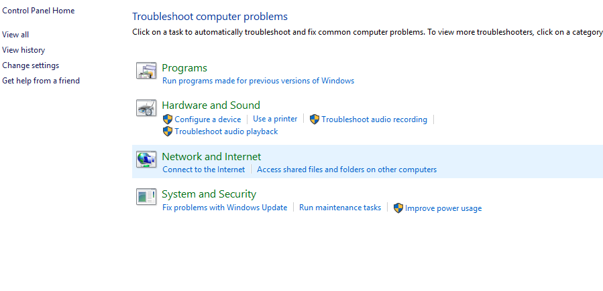
Troubleshooting
You can make sure your internet is working properly, make sure a device is working, etc.

Slide 25
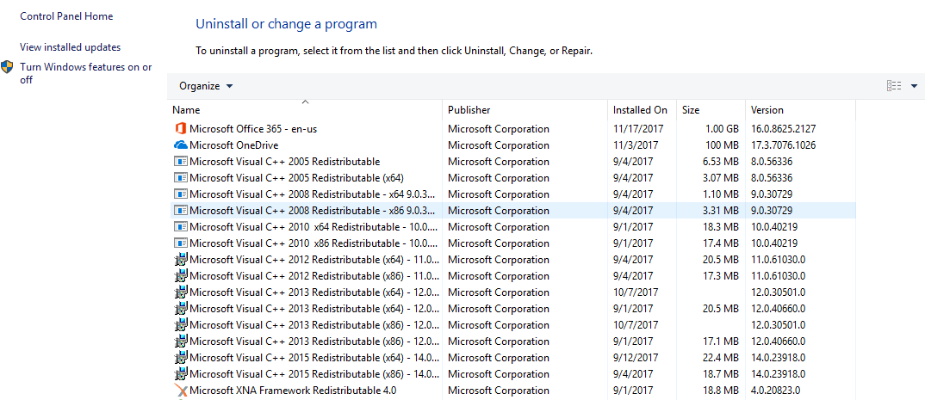
Programs and Features
Programs and Features lets you uninstall specific programs, turn some on and off specific features, etc.

Slide 26

Flash Player
Flash Player allows you to test out all of the different settings related to the Flash Player

Slide 27
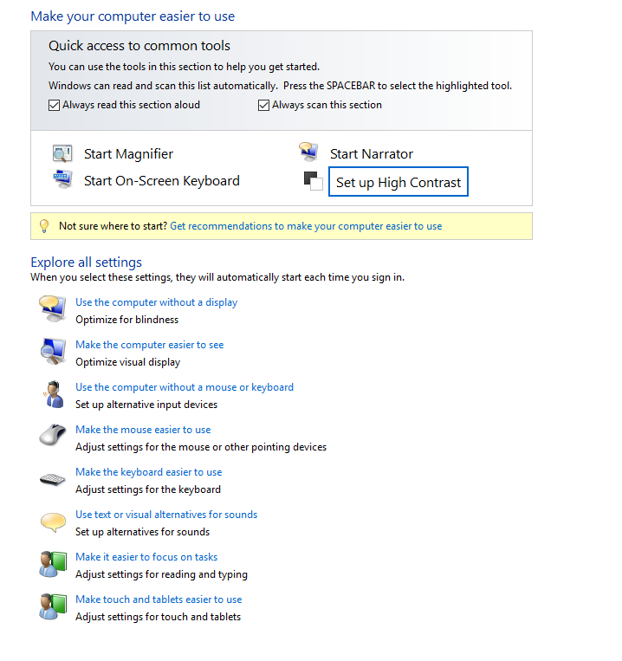
Ease of Access Center
It gives you instant access to setting changes for the keyboard and mouse, and lets you make the computer or touch features easier to use.

Slide 28
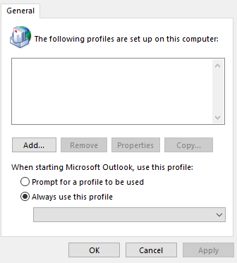
Mail
Mail lets you change the email accounts used on the computer, add new ones, remove ones, etc.

Slide 29
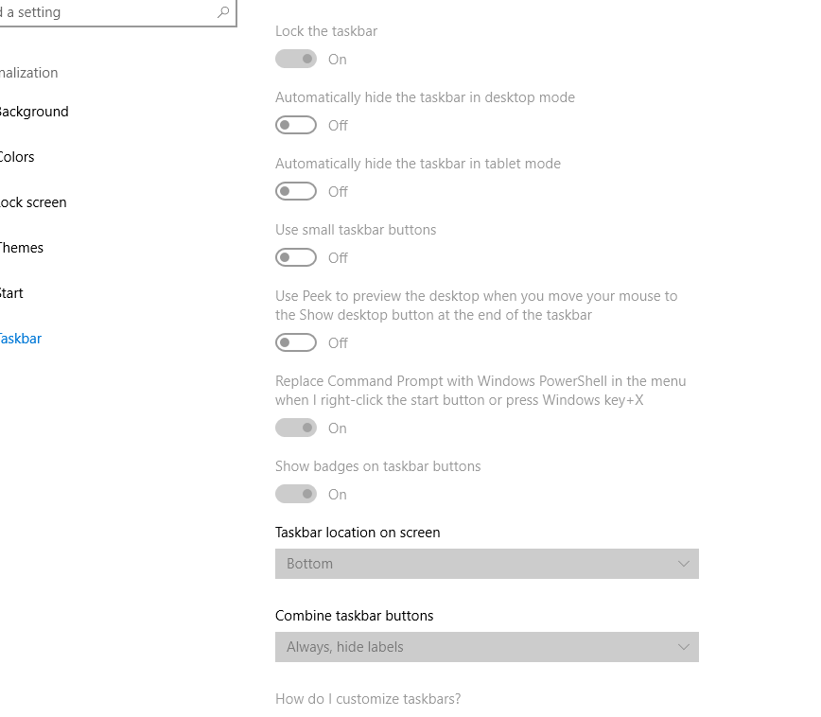
Taskbar and Navigation
Taskbar lets you lock the taskbar, hide the taskbar, change the location of the taskbar on screen, etc.

Slide 30
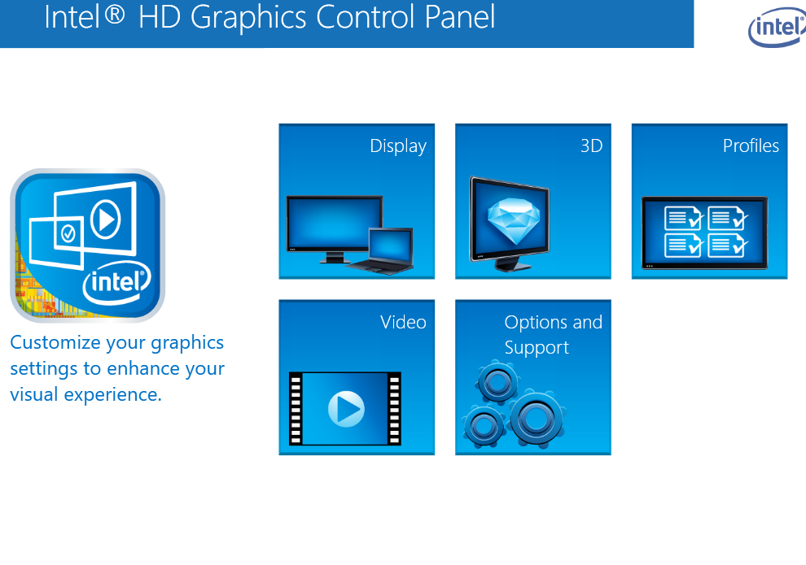
Intel Graphics and Media
This lets you change the screen resolution, change the refresh rate, manage the hotkeys, etc.

Slide 31
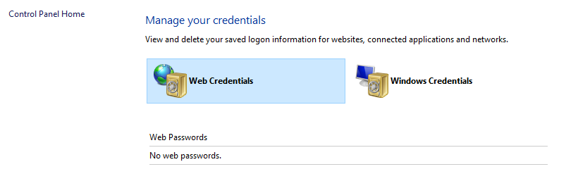
Credential Manager
You can view or delete whatever credentials for websites, networks, applications.

Slide 32
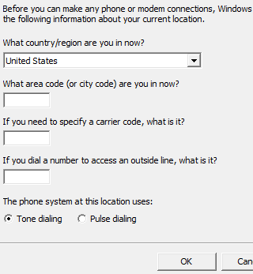
Phone and modem
You can connect to phones/modems by your location, carrier code, etc.

Slide 33
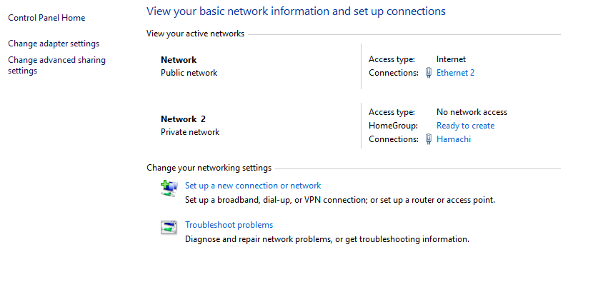
Network and Sharing Center
This lets you set up a network, an ethernet connection, a wi-fi connection, troubleshoot network problems, etc.

Slide 34
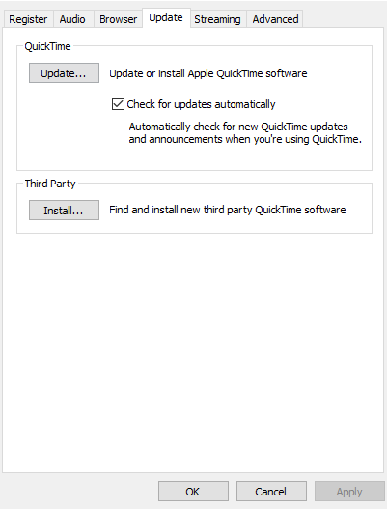
Quicktime
You can modify the audio rate, update Quicktime, install third party Quicktime software, etc.

Slide 35
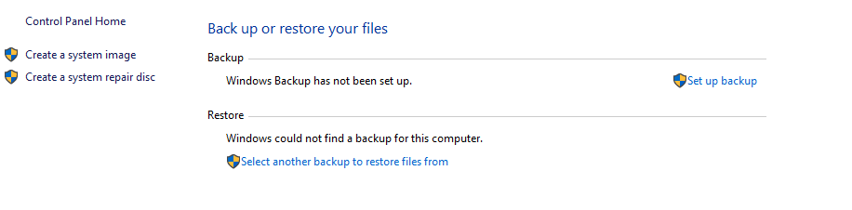
Backup and Restore
You can set up backups for Windows, files, create system images, system repair discs, etc.

Slide 36
RemoteApp and Desktop Connections
As an administator, you can provide resources, like virtual desktops and RemoteApp programs to your users.

Slide 37
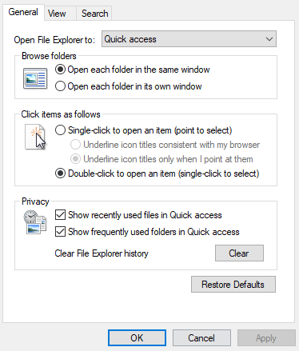
File explorer options
You can use change where File Explorer automatically opens to, change what can be seen in File Explorer, etc.

Slide 38
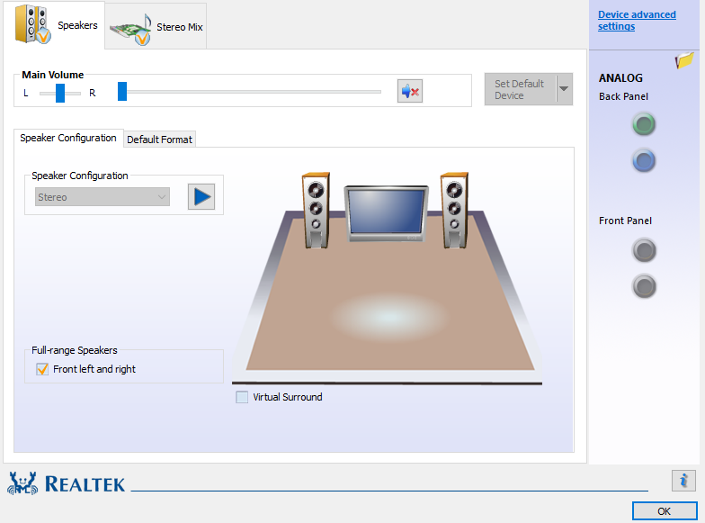
Realtek HD Audio Manager
You can make sure your speakers/headphones are working, set the volume, set the speaker configuration, and more.

Slide 39
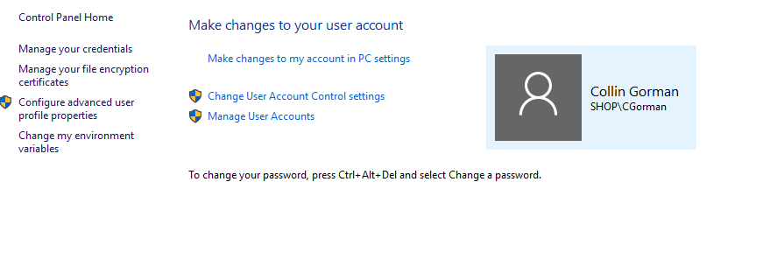
User Accounts
You can change aspects of your account, such as your password, add new accounts, manage other user accounts, and more.

Slide 40
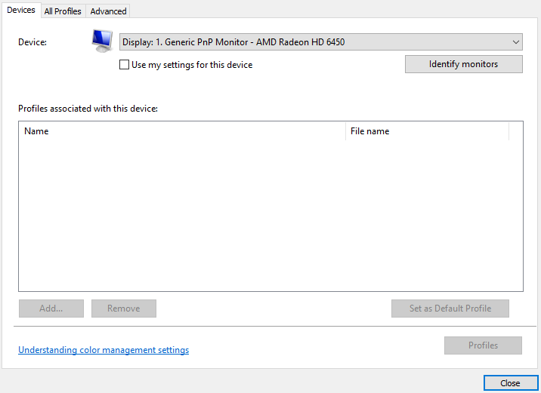
Color Management
Color Management lets you change the colors your monitor will display. You can also set profiles for who will get these changes.

Slide 41
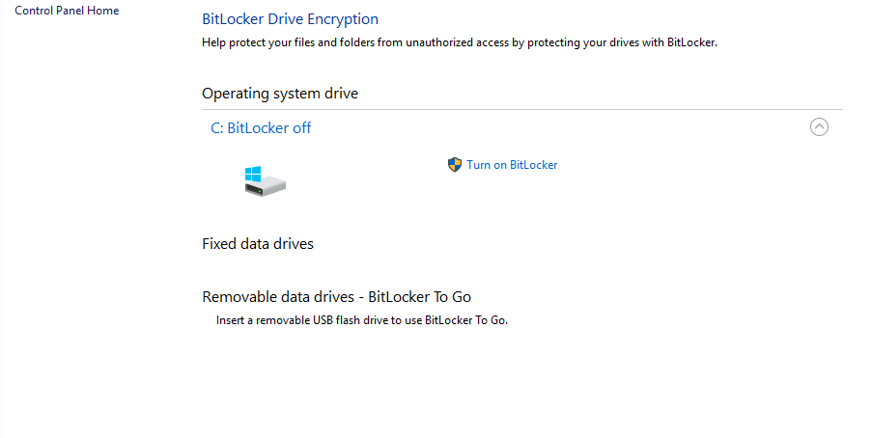
BitLocker Drive Encryption
BitLocker protects your drives from unauthorized access. You can also bring BitLocker into a USB drive.

Slide 42
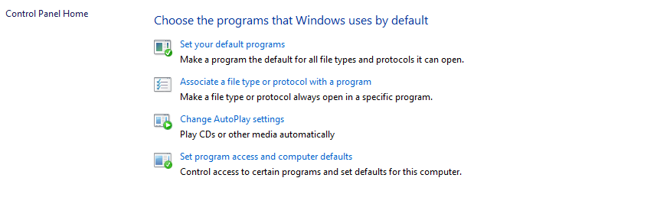
Default Programs
This lets you make a protocol open with a specific program, set a default program for what file types to open, etc.

Slide 43
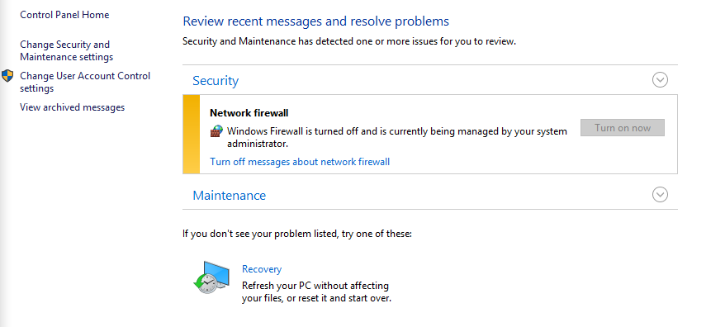
Security and Maintenance
You can see if your firewall is enabled or disabled, or you can refresh your computer without the files being affected.

Slide 44
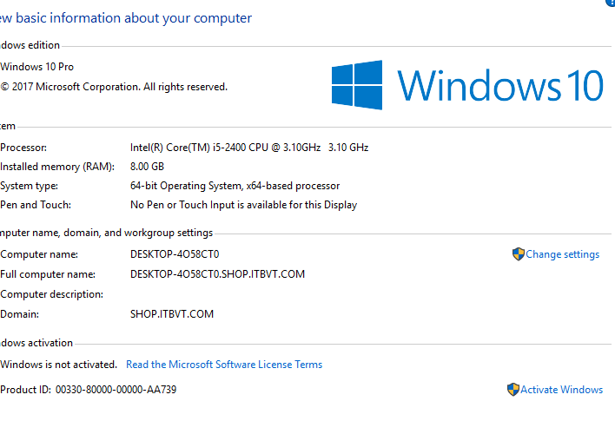
System
You can see your computer's information, specifically your processor, your RAM, your computer name/domain, and your system type.

